Slide 1

BIN-500
Plain Population Variant Detection
By: Sam Hall, Logan Peachey, and Sierra Rossman

Slide 2
TABLE OF CONTENTS
01
02
03
04
05
06
INTRODUCTION
OBJECTIVE
METHODS
RESULTS/DISCUSSION
CONCLUSION
FUTURE DIRECTION

Slide 3

01
INTRODUCTION

Slide 4


INTRODUCTION
Plains populations: Swiss immigrants, socially isolated
Recessive disorders common because of small gene pool
Causes the Founder Effect
Reduction of genomic variability
Explains why these (often fatal) inherited diseases are found more frequently

Slide 5
02
OBJECTIVE
First, identify a known variant within the Plains population
Showcase the results of the genetic variant and common symptoms
Then, identify a novel variant within the Plains population
Discuss the potential outcomes for this variant

Slide 6
03
METHODS

Slide 7
METHODS
Collect blood samples from the 99 individuals within the Plains people
Utilize whole exome sequencing on the Illumina platform
Produce variant call files and filter the genomic variants to select a known and unknown variant
Analyze the results based on known literature and current medical data

Slide 8
VCF filtering
Known variant
Unknown variant
formatted_positions-annotated-combined-High.vcf
Command:
cat formatted_positions-annotated-combined-HIGH.vcf | grep stop_gained | grep -v BaseQRankSum=-
Produced a list of 6 gene variants
Selected the gene with the highest variant frequency in the cohort
annotated-HIGH.vcf
Command:
cat annotated-HIGH.vcf | grep -E -v 'UTR|pseudogene|splice|intron|MODERATE|downstream|BaseQRankSum=-' | grep protein_coding | grep 1/1: | grep 0/1:
Produced a list of 160 gene variants
Proceeded to search through literature regarding the 160 genes and selected a mutation that:
Was not either over or underrepresented in the cohort
Had relevant up to date clinical information

Slide 9
04
RESULTS
&
DISCUSSION

Slide 10
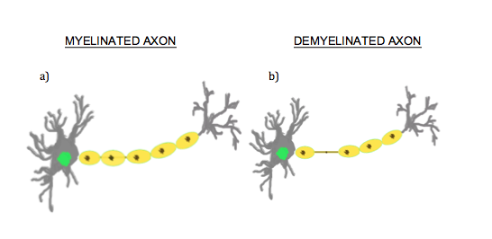
RESULTS & DISCUSSION
Known variant: SH3TC2
Disease: Charcot-Marie Tooth disease type 4C
An autosomal recessive childhood-onset neurodegenerative disease characterized by demyelination of motor and sensory neurons.
Context:
Variant observed in 5 individuals
Heterozygous
Located on Chromosome 5
Position 148,406,435
Single nucleotide polymorphism
G to A
Stop codon introduced resulting in
faulty protein
Common features:
Thoracic spine scoliosis
Moderate to severe neuropathy
Cranial nerve deficits
Notes:
https://www.ncbi.nlm.nih.gov/pmc/articles/PMC5886823/

Slide 11
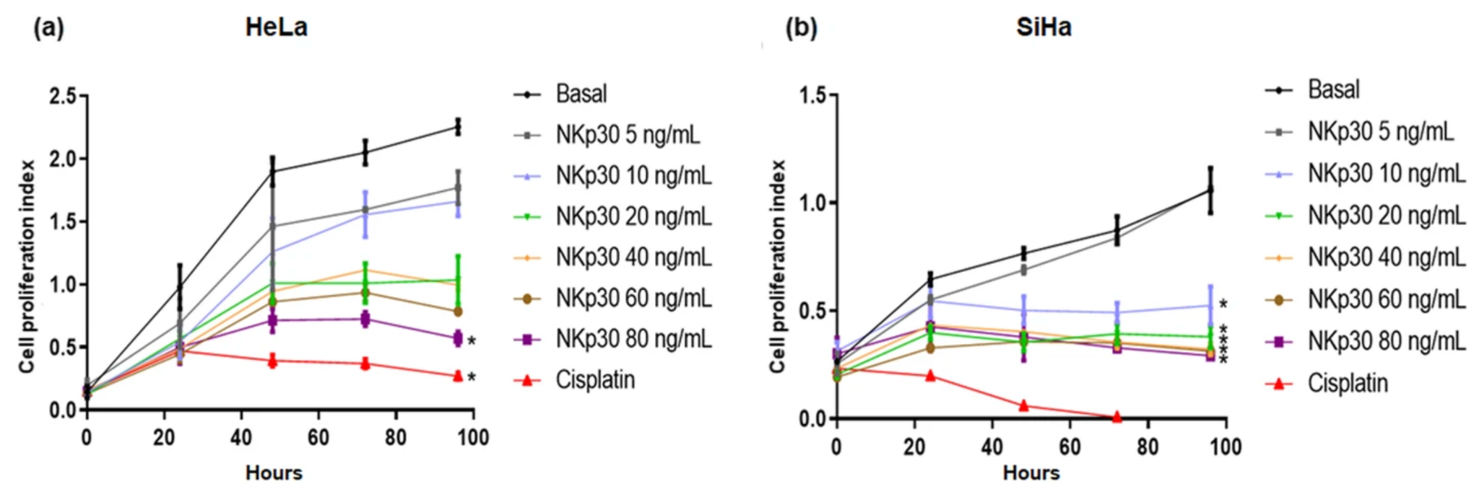
RESULTS & DISCUSSION
Unknown variant: Ncr3LG1
Location: Chromosome 11, Position 17,394,037-17,394,039
Frameshift variation
Deletion of CTT to a single C
10 heterozygous individuals
1 homozygous individual
Mutation occurs in exon 5 of the Ncr3LG1 gene on NCBI
Gene function:
Produces B7-H6 protein
B7-H6 acts as an immunoligand with antigen receptor NPk30 to activate natural killer cells
Figure 1. Banu et al.
Showing decreased cervical cancer cell proliferation with addition of NKp30
Notes:
https://www.ncbi.nlm.nih.gov/pmc/articles/PMC7944329/
https://www.sciencedirect.com/science/article/pii/S002432052200409X - therapeutic potential
https://bmccancer.biomedcentral.com/articles/10.1186/s12885-020-07608-4 - inhibitory effects on cell proliferation and migration, but not apoptosis
https://www.sciencedirect.com/science/article/pii/S1556086421020669

Slide 12
Results and Discussion
B7-H6
B7 Family
Two distinct functions:
Assist tumor invasion via stimulation of NK-cell-mediated cytotoxicity
Impair the T-cell antitumor function by influencing immune-mediated killing of tumor cells
Low to no expression in healthy cells
High expression in many malignant tumors
Lymphoma
Leukemia
Gastric carcinoma
Cervical carcinoma
Breast cancer
Ovarian cancer
And many more
B7-H6 protein has minimal and conflicting research
Existing research indicates that B7-H6 may have a positive impact in immunotherapy efforts and in improving prognosis
Modulates immune responses by providing co-inhibitory or co-stimulatory signals through interaction with their receptors
Various B7 proteins are being researched for their immunotherapy properties

Slide 13
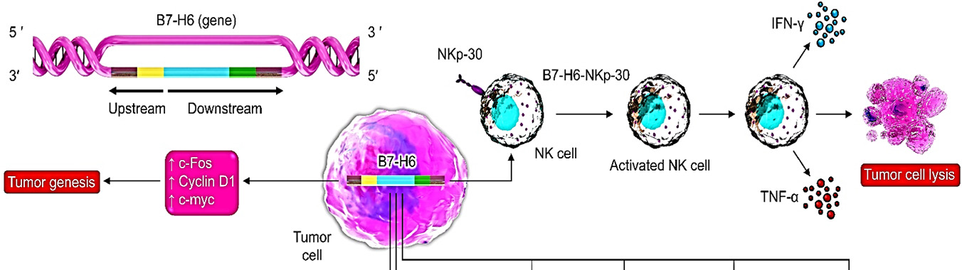
Results and Discussion
B7-H6
The potential of B7-H6 as a therapeutic target in cancer immunotherapy

Slide 14
Cancer-specific
⬆ White Blood cell markers
⬆ B7-H6
No effect/⬇ apoptosis
⬇ Migration
⬇ Proliferation
Notes:
Binding of B7-H6 to the natural killer cell activating receptor NKp30 starts innate immune responses for cellular transformation, stimulates anti-tumor cytotoxicity and cytokine production, and triggers tumor cell cytolysis.

Slide 15
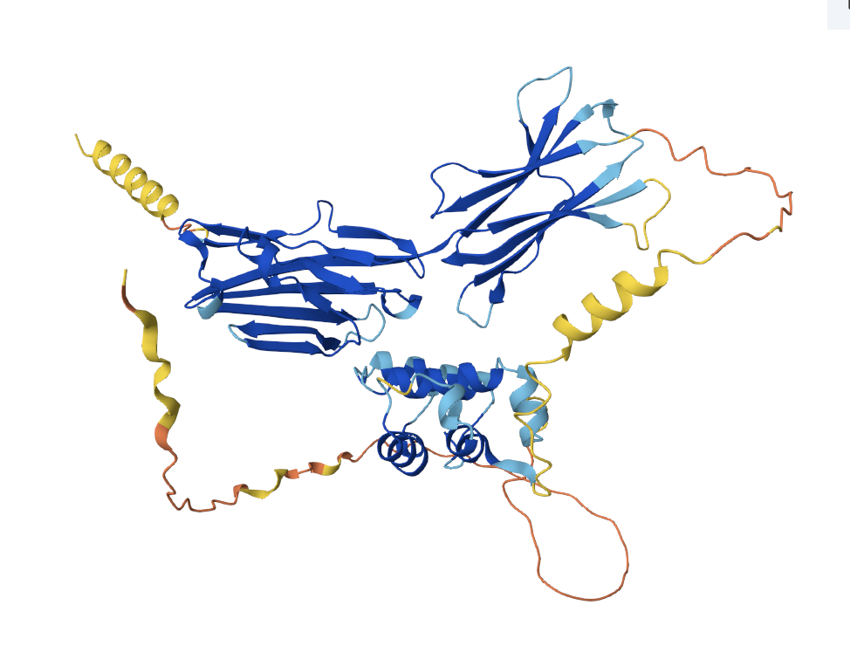
Results and Discussion
Protein Impact
N-terminus
Binding domain
Transmembrane protein
N-terminus and binding domain are in the extracellular region
C-terminus located in the cytoplasmic region
Mutation impacts polar residues on the c-terminus
TLLLPLQ -> TVTPTVNA
Adds only 1 amino acid to the chain
1 nonpolar amino acid to 4 nonpolar amino acids
Minimal impact to the protein
Potential for the increase in non polar amino acids to impact the signal transmission upon binding potentially impacting the production of natural killer cells
Transmembrane region
C-terminus
Notes:
https://www.rcsb.org/groups/3d-sequence/polymer_entity/Q68D85

Slide 16
05
CONCLUSION

Slide 17
CONCLUSIONS
What does this mean for the Plains population?
1
If variant increases B7-H6 activity, cancers could be more treatable
2
If variant decreases B7-H6 activity, any cancer has a greater likelihood of being more aggressive and spreading quickly
What do we do with this information?
Further investigate the instance of cancer within the plains population
If there is a difference in instance from the general population, consider the correlation with the Ncr3LG1 variant

Slide 18
06
FUTURE DIRECTION

Slide 19
FUTURE DIRECTIONS
Investigate the Cancer Prevalence in the Plains Population
Potential Therapeutic Use
Assess the impact of the variant
Consider the differences in sex (commonalities of female-associated cancers)
Investigate if B7-H6 supplements could be useful in immunotherapy for patients with cancer
Investigate the potential improved prognosis of cancer using B7-H6
Notes:
Site directed mutagenesis for Ncr3LG1 mutation

Slide 20
THANK YOU
Questions?

Slide 21
LITERATURE CITED
Banu, N., Riera-Leal, A., Haramati, J., Ortiz-Lazareno, P. C., Panikar, S. S., Bastidas-Ramirez, B. E., Gutierrez-Silerio, G. Y., Solorzano-Ibarra, F., Tellez-Ba&ntilde;uelos, M. C., Gutierrez-Franco, J., Bueno-Topete, M. R., Pereira-Suarez, A. L., & Toro-Arreola, S. del. (2020, November 10). B7-H6, an immunoligand for the natural killer cell activating receptor NKP30, reveals inhibitory effects on cell proliferation and migration, but not apoptosis, in cervical cancer derived-cell lines - BMC cancer. BioMed Central. https://bmccancer.biomedcentral.com/articles/10.1186/s12885-020-07608-4
Jerath, N. U., Mankodi, A., Crawford, T. O., Grunseich, C., Baloui, H., Nnamdi-Emeratom, C., Schindler, A. B., Heiman-Patterson, T., Chrast, R., & Shy, M. E. (2018, May 1). Charcot-Marie-Tooth Disease Type 4C: Novel Mutations, Clinical Presentations, and Diagnostic Challenges. U.S. National Library of Medicine. https://www.ncbi.nlm.nih.gov/pmc/articles/PMC5886823/
Mohammadi, A., Najafi, S., Amini, M., Mansoori, B., Baghbanzadeh, A., Hoheisel, J. D., & Baradaran, B. (2022, June 11). The potential of B7-H6 as a therapeutic target in cancer immunotherapy. Life Sciences. https://www.sciencedirect.com/science/article/pii/S002432052200409X
Notes:
https://www.sciencedirect.com/science/article/pii/S002432052200409X

Slide 22
LITERATURE CITED
National Institute of Health. (2024, April 19). Founder Effect. National Human Genome Research Institute. https://www.genome.gov/genetics-glossary/Founder-Effect
National Science Foundation. (n.d.). RCSB PDB group sequence: Q68D85. RCSB Protein Data Bank. https://www.rcsb.org/groups/3d-sequence/polymer_entity/Q68D85
Puffenberger, E. G., Jinks, R. N., Sougnez, C., Cibulskis, K., Willert, R. A., Achilly, N. P., Cassidy, R. P., Fiorentini, C. J., Heiken, K. F., Lawrence, J. J., Mahoney, M. H., Miller, C. J., Nair, D. T., Politi, K. A., Worcester, K. N., Setton, R. A., Dipiazza, R., Sherman, E. A., Eastman, J. T., … Strauss, K. A. (2012, January 17). Genetic Mapping and Exome Sequencing Identify Variants Associated with Five Novel Diseases. U.S. National Library of Medicine. https://www.ncbi.nlm.nih.gov/pmc/articles/PMC3260153/
Thomas, P. L., Groves, S. M., Zhang, Y.-K., Li, J., Gonzalez-Ericsson, P., Sivagnanam, S., & Betts, C. B. (2021, April 8). Beyond programmed death-ligand 1: B7-H6 emerges as a potential immunotherapy target in SCLC. Journal of Thoracic Oncology. https://www.sciencedirect.com/science/article/pii/S1556086421020669
Notes:
https://www.sciencedirect.com/science/article/pii/S002432052200409X

